Slide 1
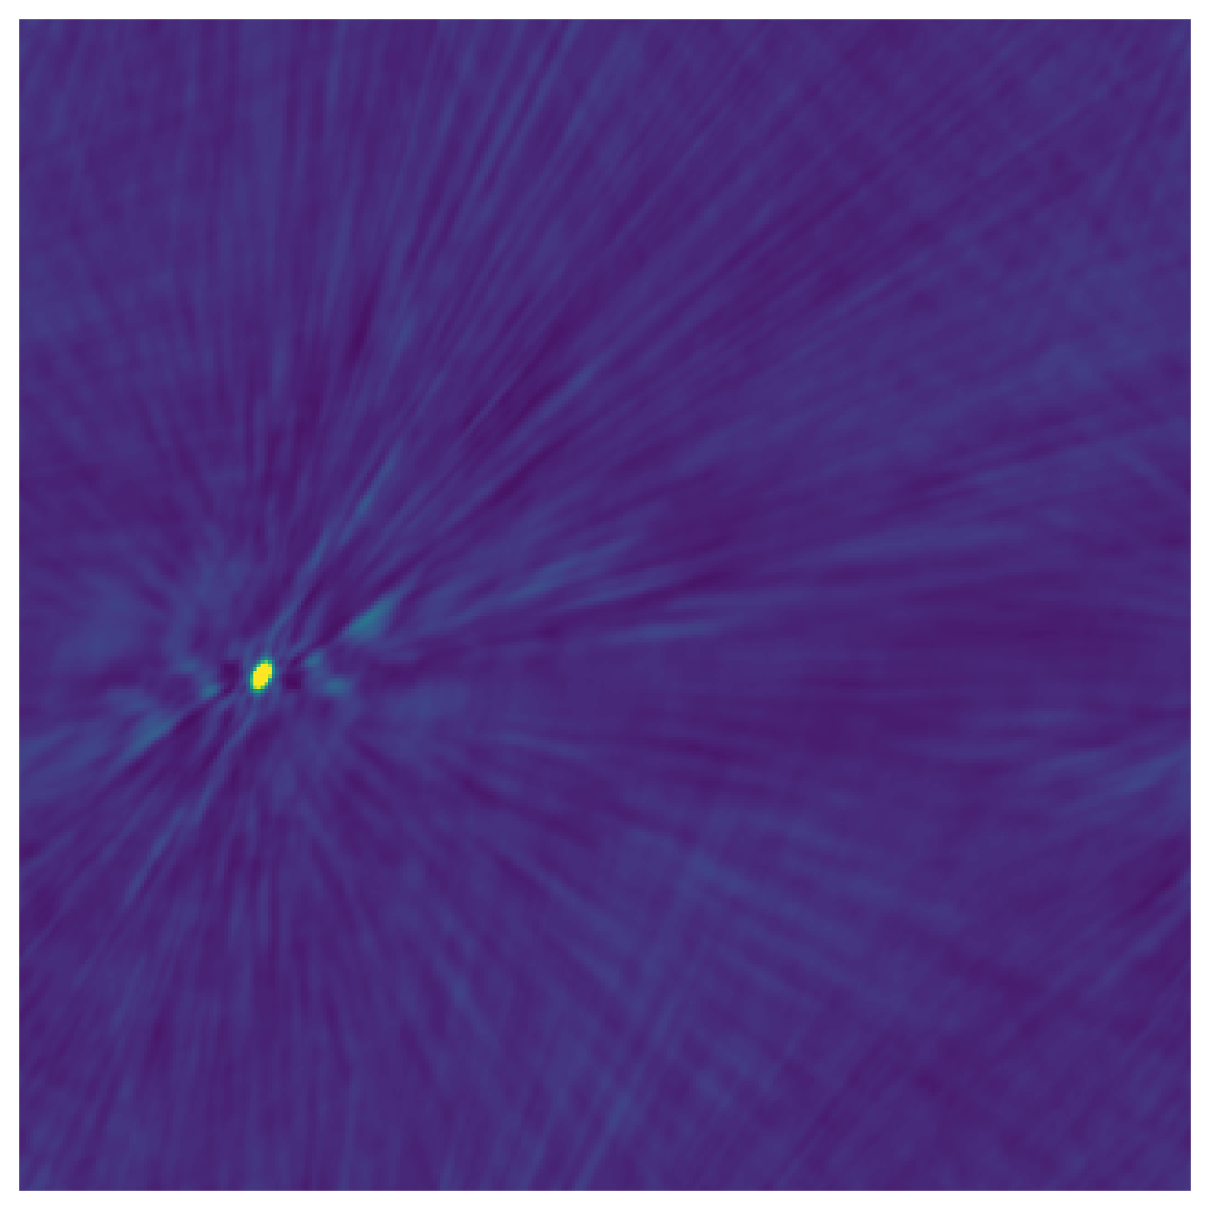
Folding Visibilities Where No Visibilities Have Been Folded Before
Ryan White
with Andrew Zic and Vivek Gupta
CSIRO Undergraduate Studentship 2024-25

Slide 2
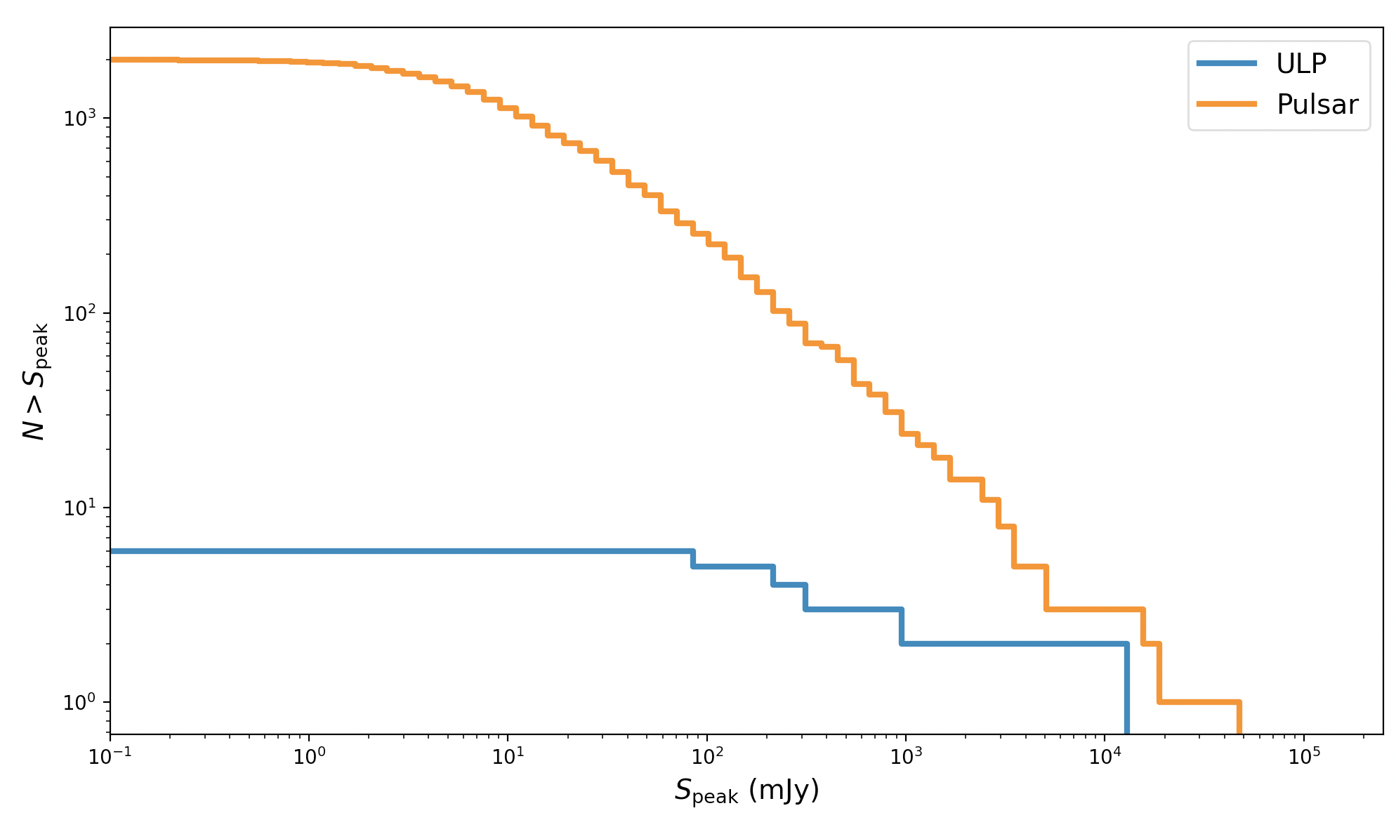
Long Period Transients
With new wide-field surveys, a handful of extremely bright, ultra-long period radio sources have been found
So far this has been purely by chance
Does this imply a hidden population of low-brightness, long period transients?
How do we find them?

Slide 3
Long Period Transient Detection
The FFT
Has been the workhorse tool for pulsar discoveries
Must be performed on time series flux
Not so sensitive to pulses with a small duty cycle

Slide 4
Long Period Transient Detection
The FFT
Has been the workhorse tool for pulsar discoveries
Must be performed on time series flux
Not so sensitive to pulses with a small duty cycle
The FFA
Has been used to discover a handful of pulsars
More natural choice to work with complex visibilities
Sensitive to all duty cycles, in principle

Slide 5
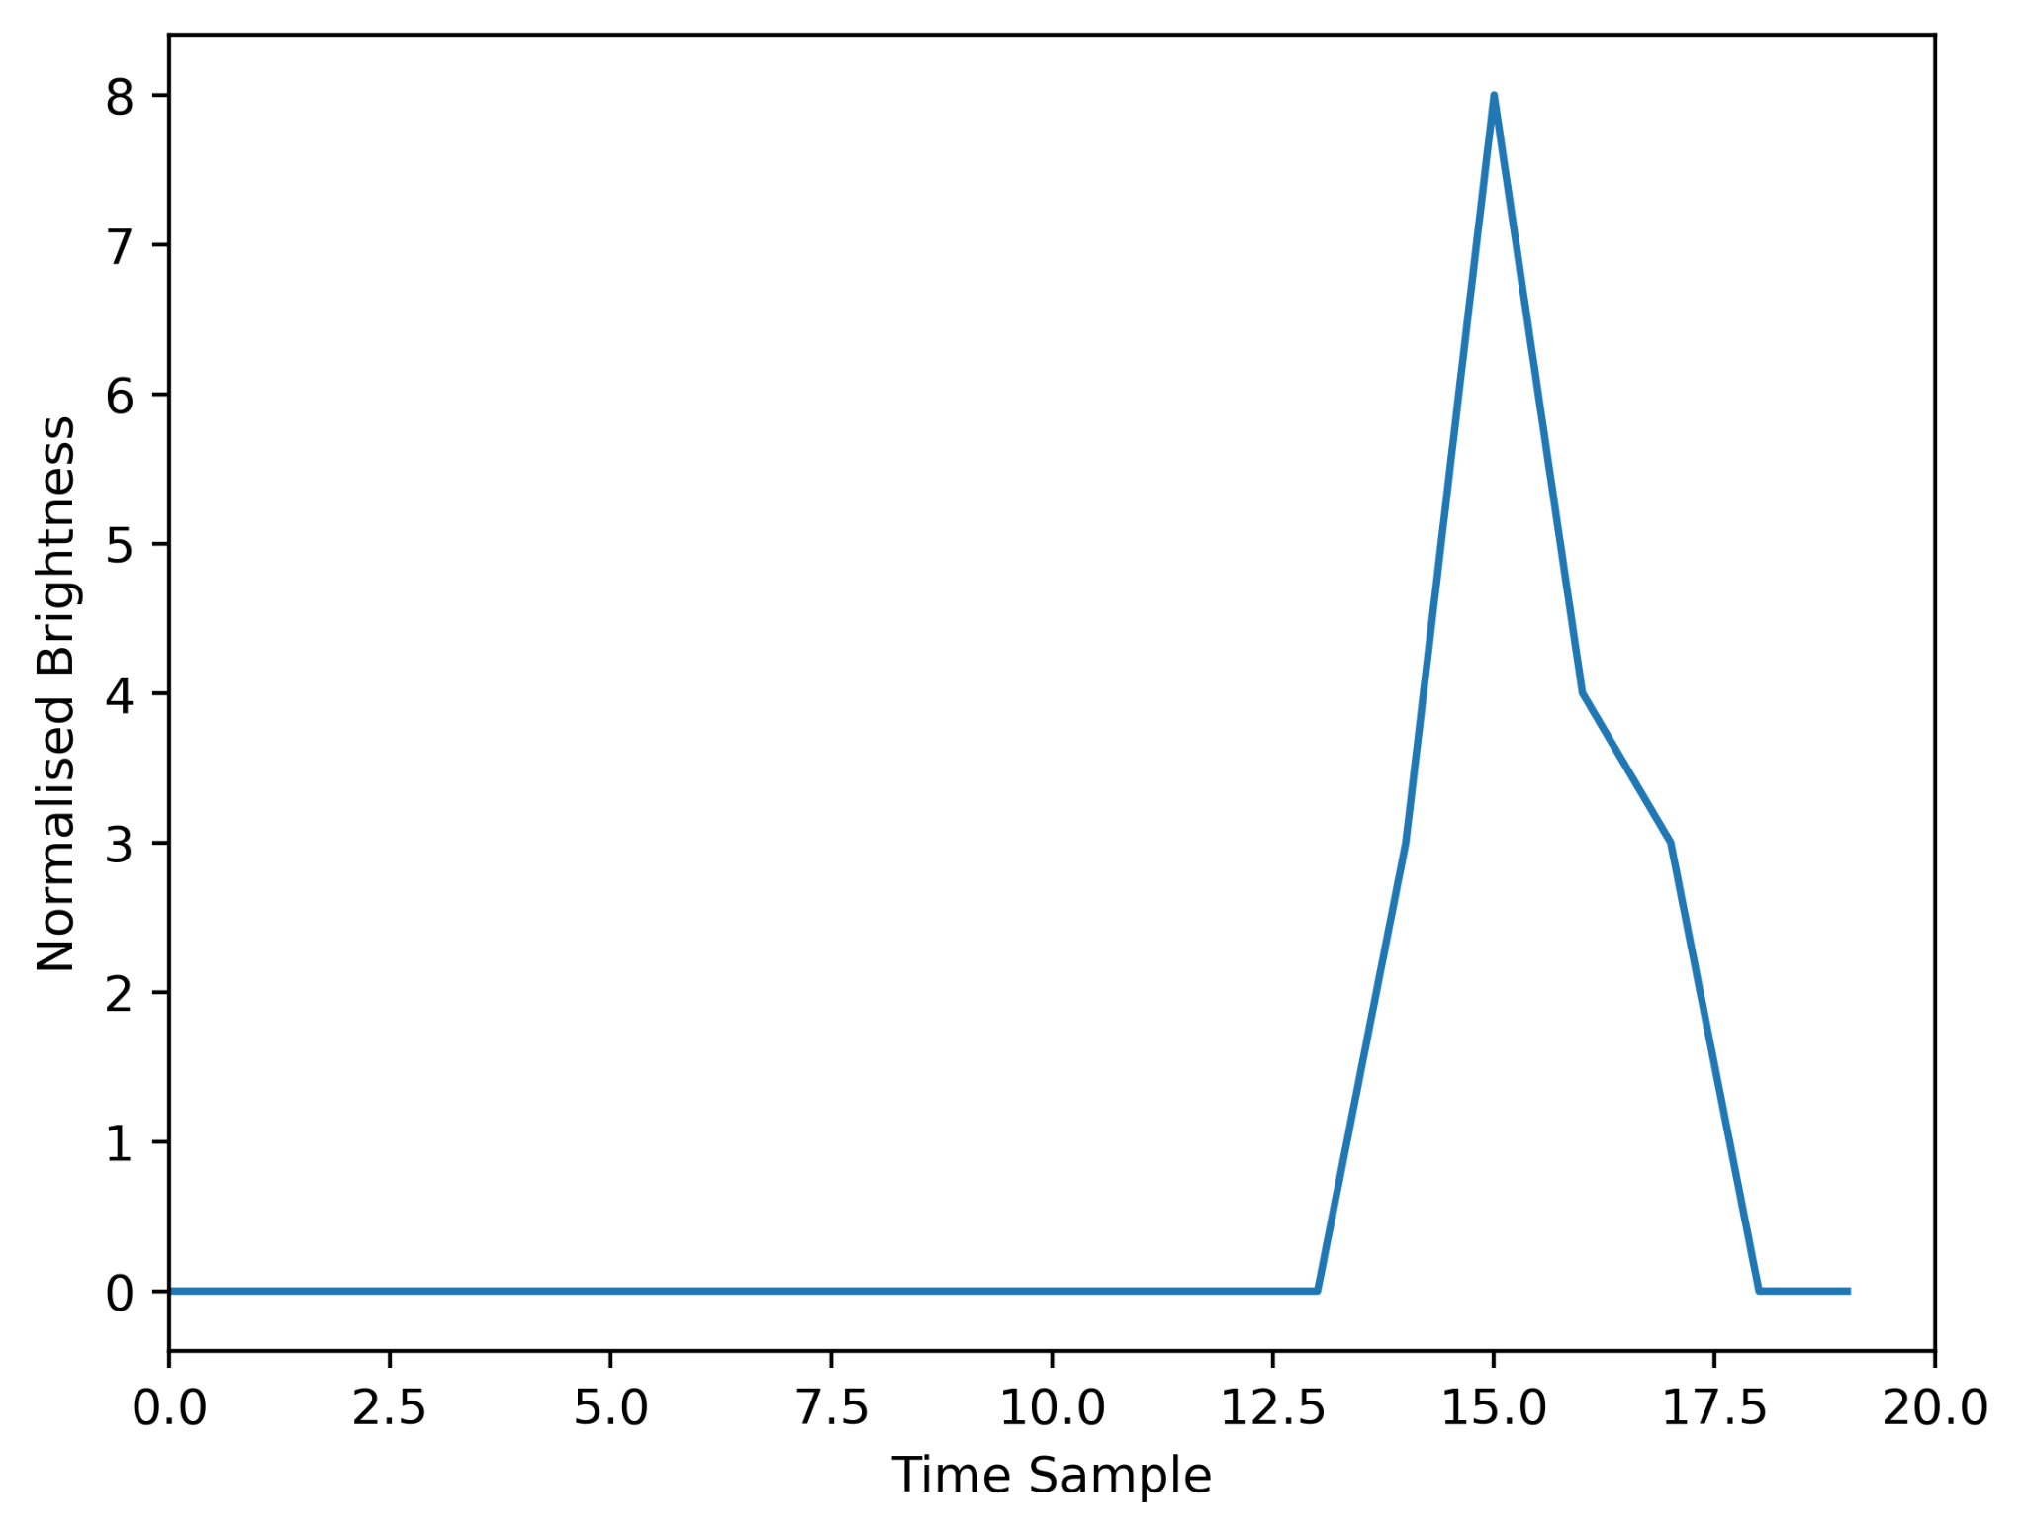
The Folding Algorithm

Slide 6
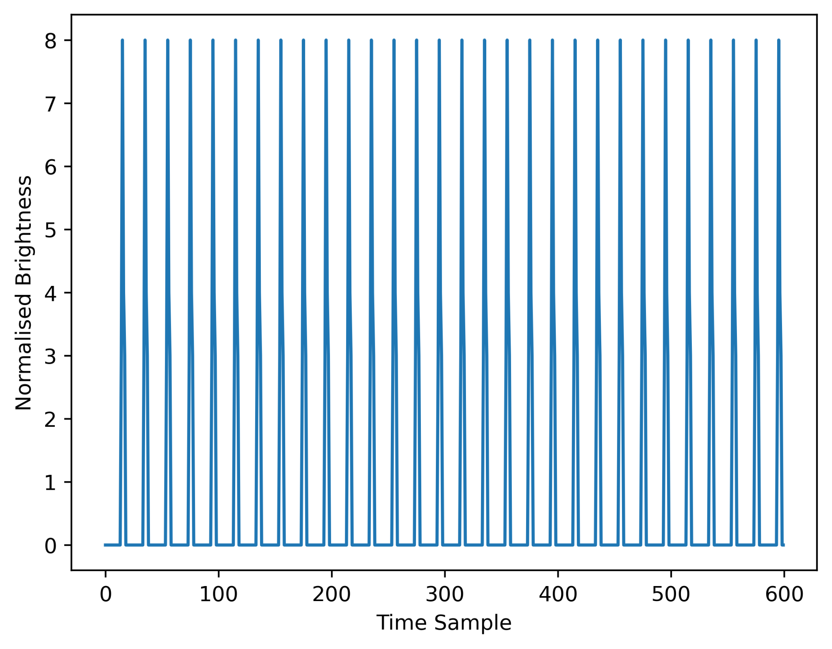
The Folding Algorithm

Slide 7
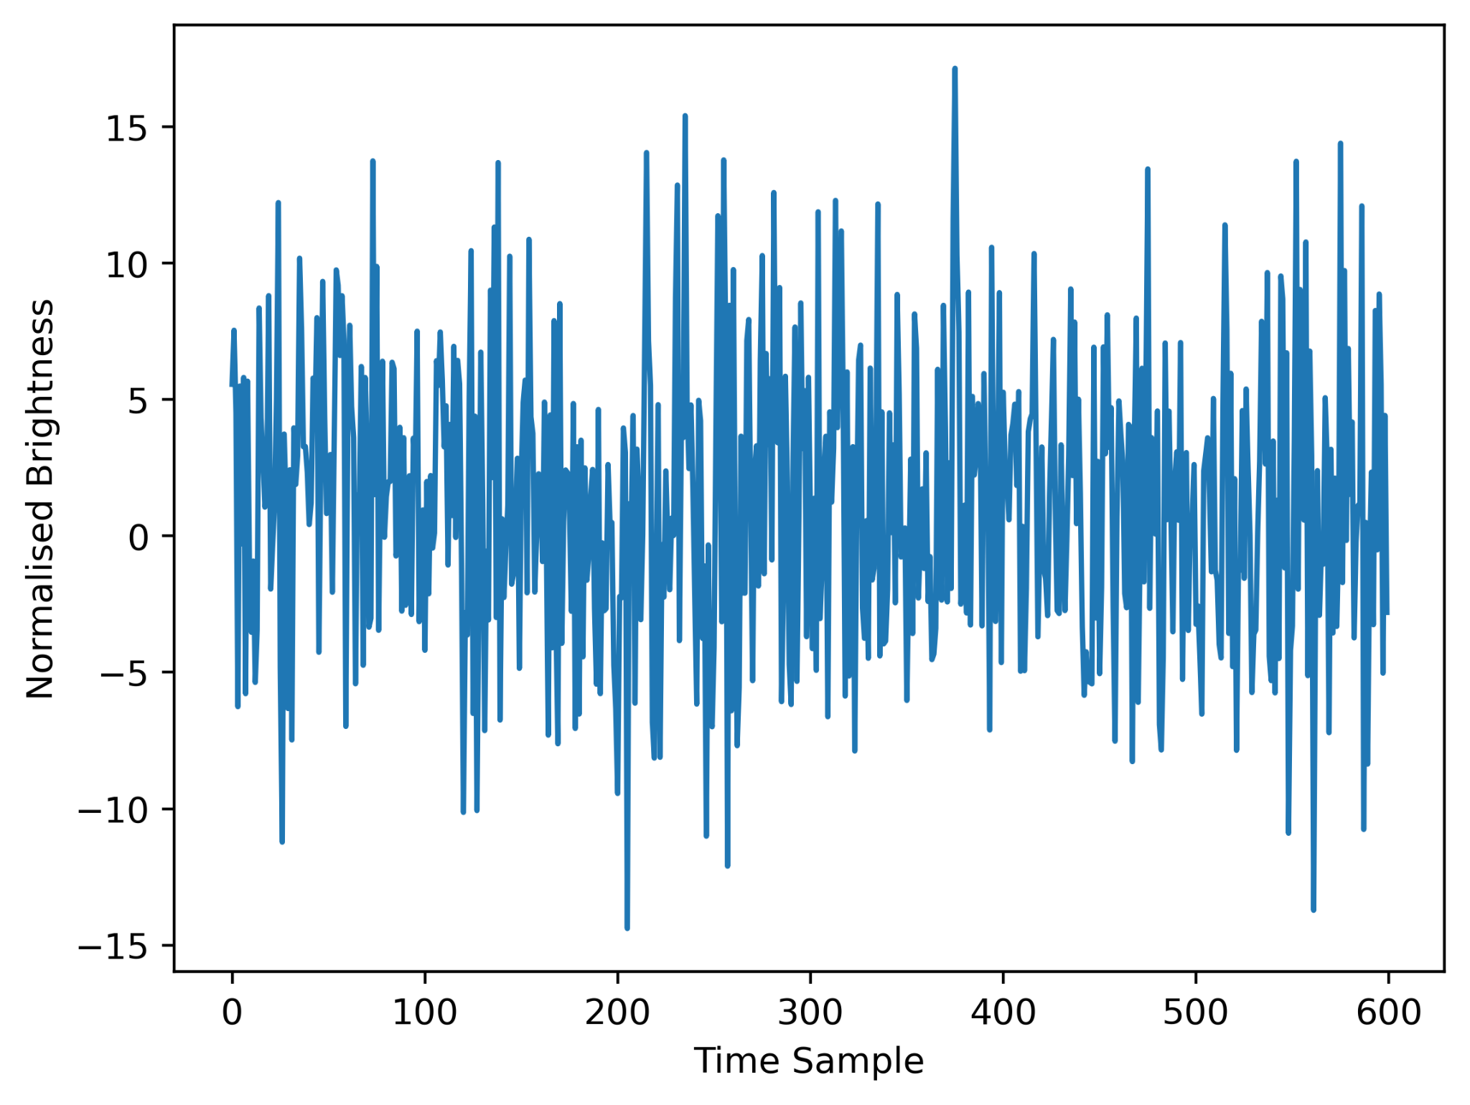
The Folding Algorithm

Slide 8
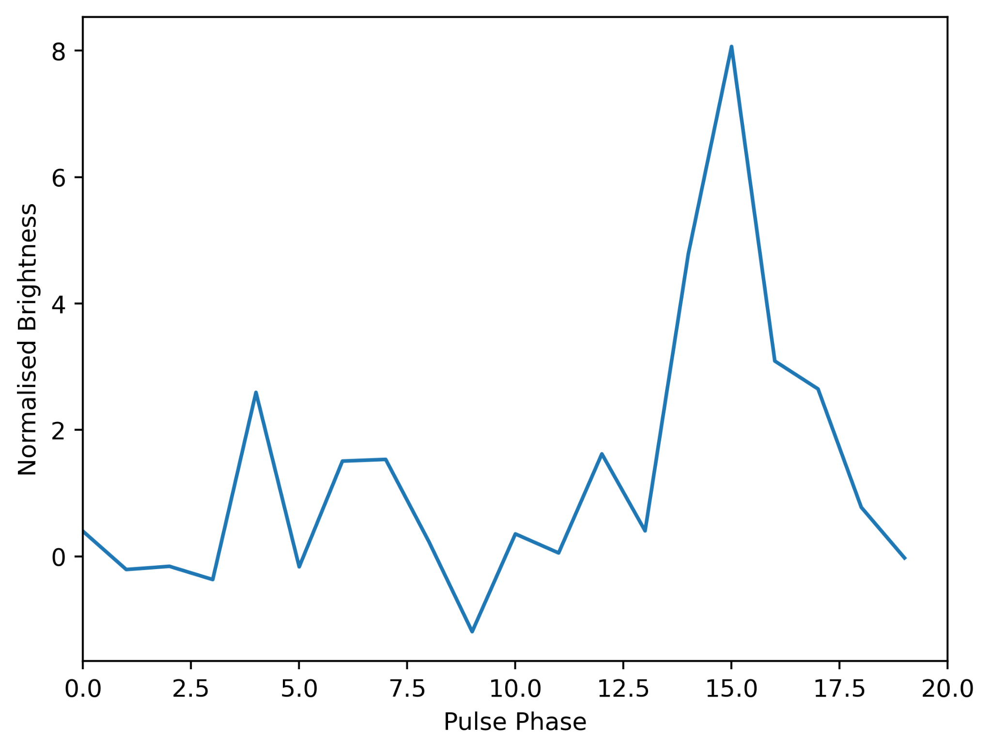
The Folding Algorithm

Slide 9
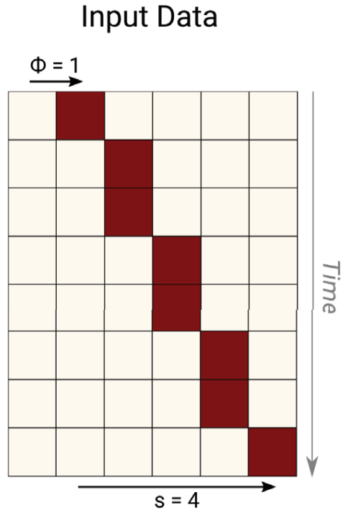
The Fast Folding Algorithm
The FFA is ‘fast’ because we can utilise some of the same sums for different periods
Images: Morello et al (2020)

Slide 10
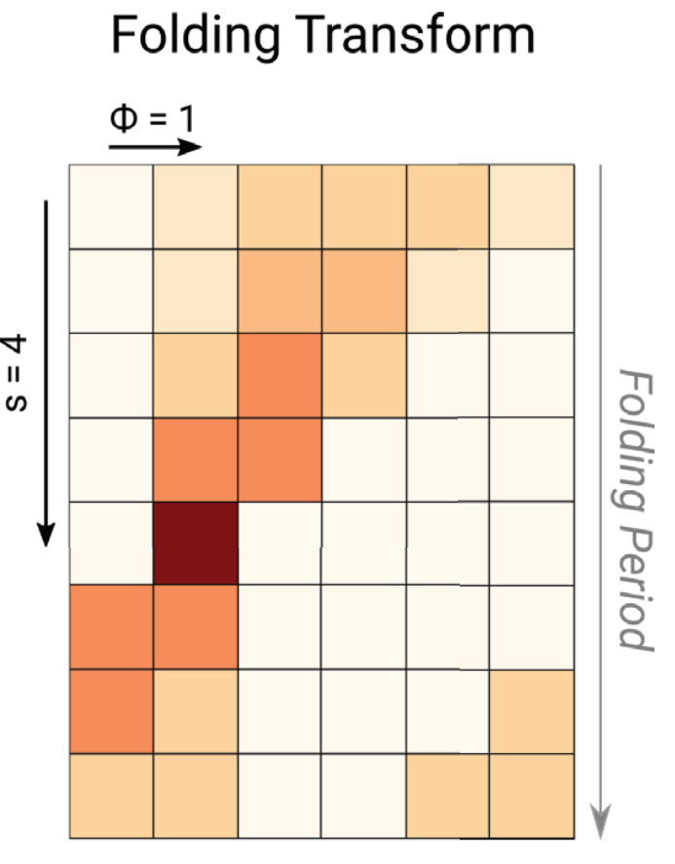
The Fast Folding Algorithm
The FFA is ‘fast’ because we can utilise some of the same sums for different periods
Images: Morello et al (2020)

Slide 11
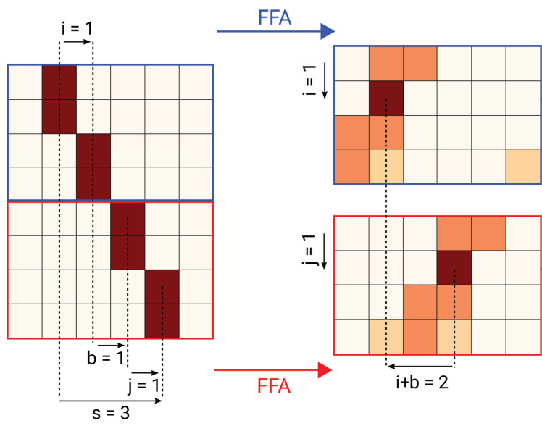
The Fast Folding Algorithm
The FFA is ‘fast’ because we can utilise some of the same sums for different periods
Images: Morello et al (2020)

Slide 12
The Fast Folding Algorithm
The FFA is ‘fast’ because we can utilise some of the same sums for different periods
Still, previous FFA implementations are slow…
Need to process every image pixel in every time sample
Images: Morello et al (2020)

Slide 13
The Fast Folding Algorithm
The FFA is ‘fast’ because we can utilise some of the same sums for different periods
Still, previous FFA implementations are slow…
Need to process every image pixel in every time sample
Could we do the FFA directly on visibility data?
Images: Morello et al (2020)

Slide 14
Long Period Transient Detection
Image plane
Periodicity search along every pixel of a time series of images
Every image needs to be made beforehand
Visibility plane
Periodicity search on every uv-cell covered by our array
Only make images for folded phases

Slide 15
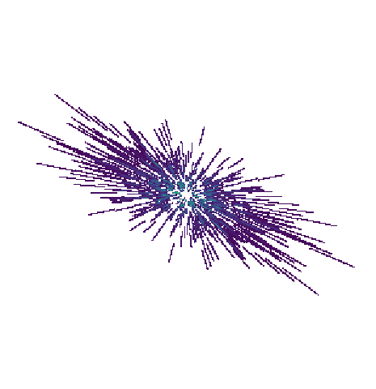
The Fast Folding Algorithm
The FFA is ‘fast’ because we can utilise some of the same sums for different periods
Still, previous FFA implementations are slow…
Need to process every image pixel in every time sample
Could we do the FFA directly on visibility data?
This means we do our folding pre-imaging, in the process avoiding overhead
Not without problems…
Idea: a ‘Dynamic Grid Array’ (DGA)

Slide 16
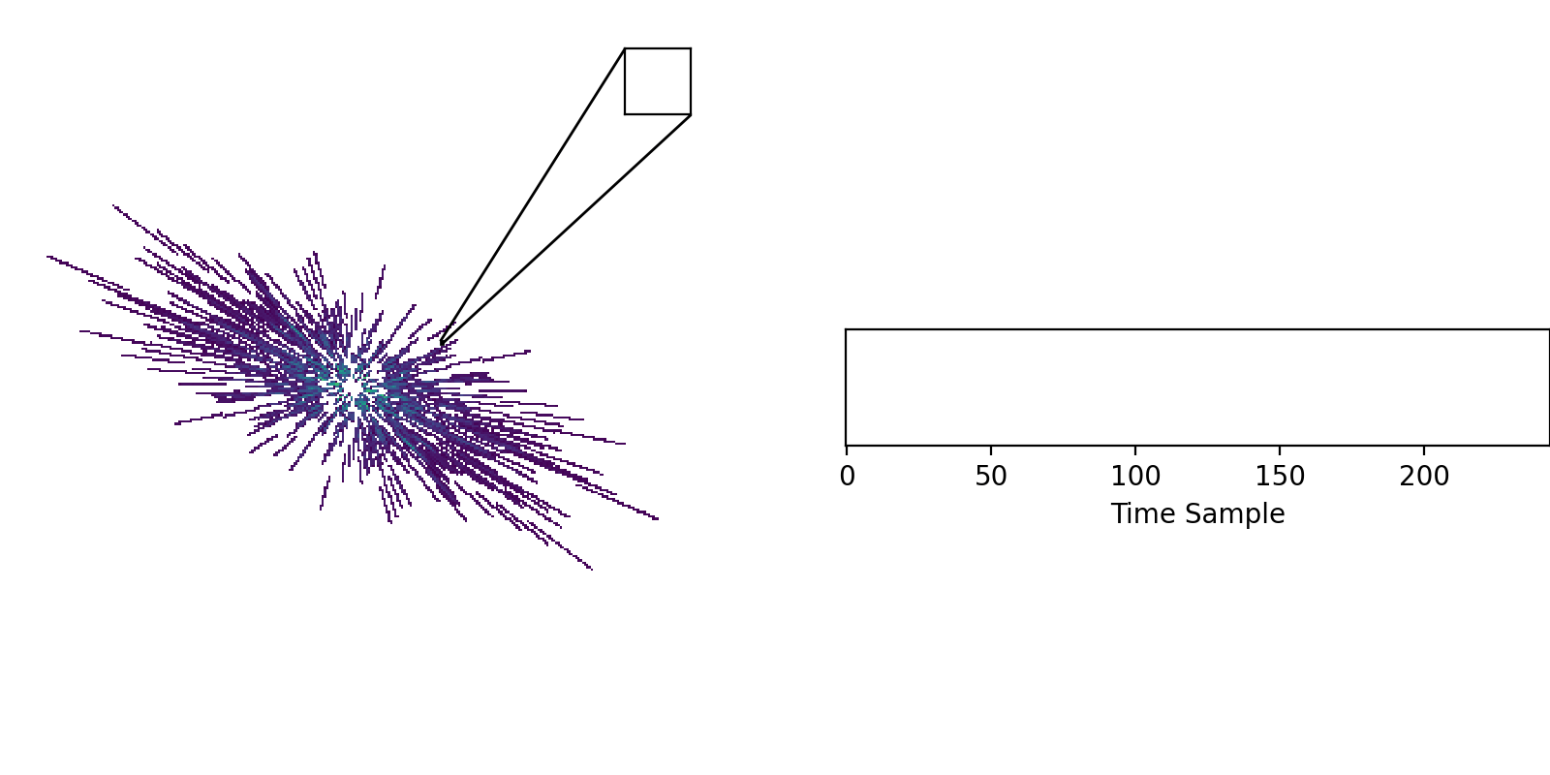
Forming the ‘DGA’

Slide 17
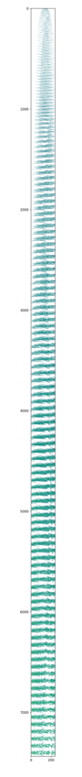
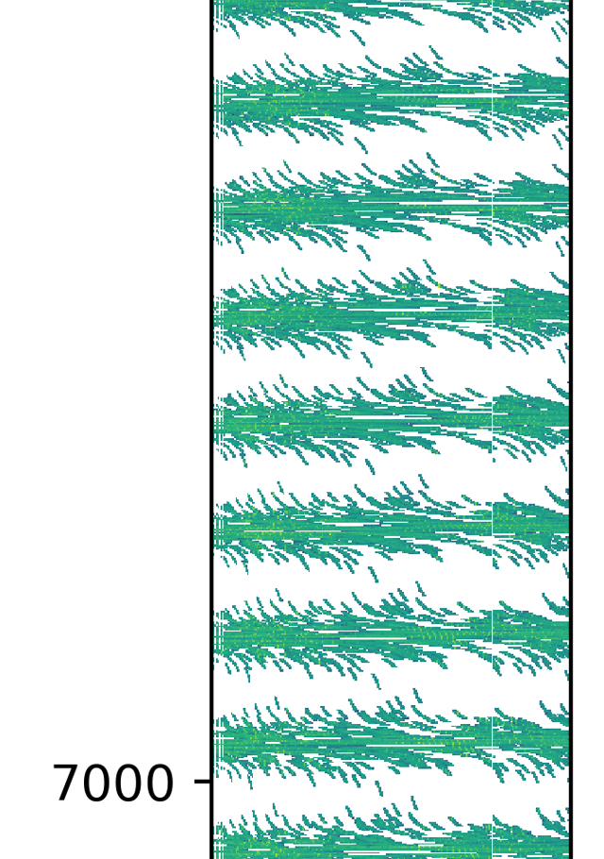
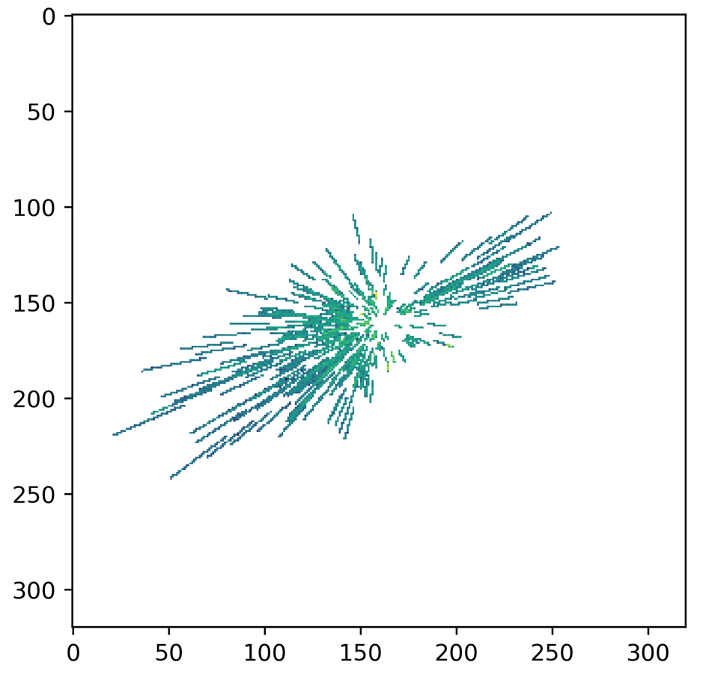
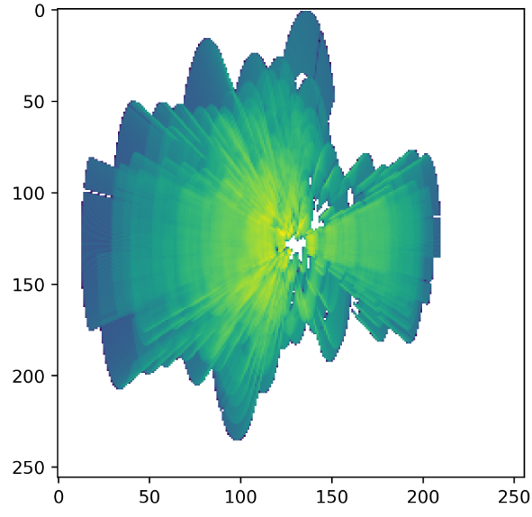
Forming the ‘DGA’
time
uv cell

Slide 18
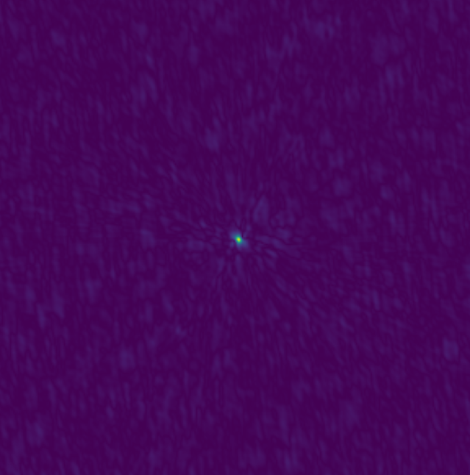
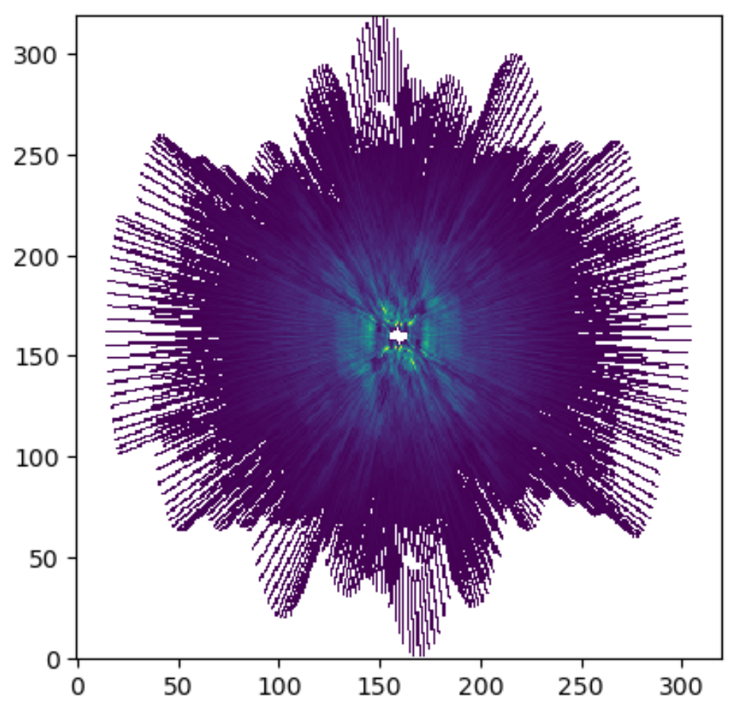
Imaging from the DGA
FFA
FFT

Slide 19
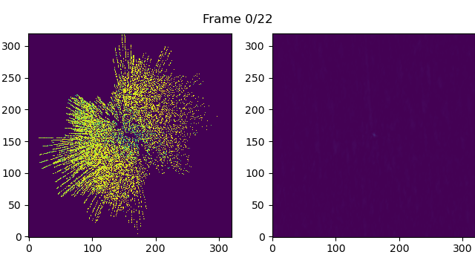
Imaging from the DGA
uv plane
image

Slide 20
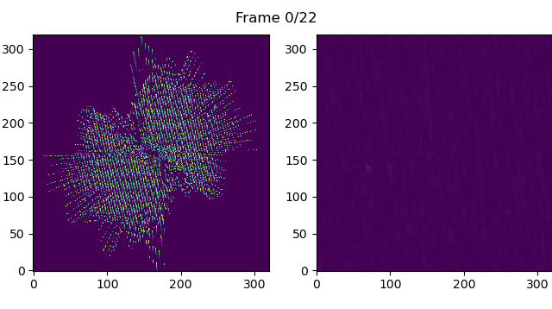
Imaging from the DGA
uv plane
image

Slide 21
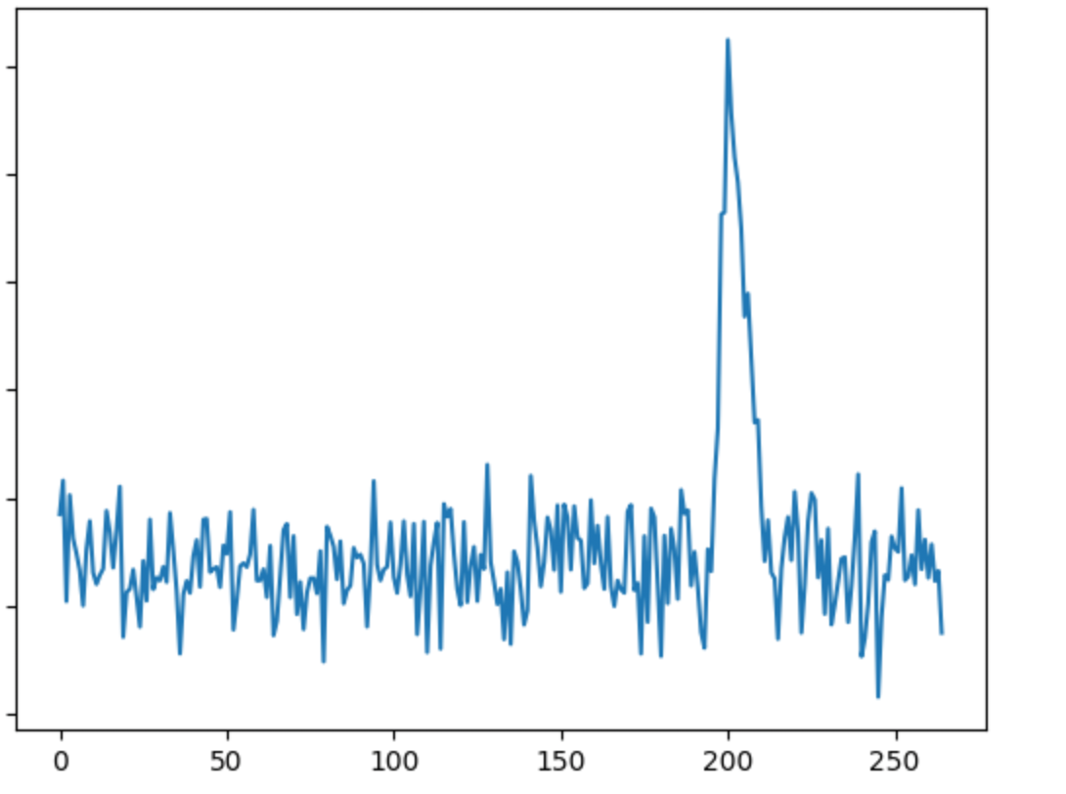
Imaging from the DGA
Works well for sources both near and far from the phase centre
Works well even when injecting noise comparable to the single-pulse brightness
Viable for low SNR sources which are yet to be discovered
Brightness
Pulse phase bin

Slide 22
Summary and Future Work
We’ve developed a way to make the FFA more ‘Fast’ by performing it over visibilities
The ‘DGA’ creation is an expensive but one-time compute step
Still room to speed this up further and to reduce memory usage
Our method works well for low SNR sources both near and away from the phase centre
This is promising with regards to filling out the ‘missing population’ of low-brightness LPTs
Yet to implement an efficient search over duty cycle and DM
Testing so far has been done on a LPT with known period
Need to apply our method on new and archival data to find more LPTs!

